Slide 1
Introduction to Artificial Intelligence (AI)
By Umme Aeman

Slide 2
What is Intelligence?
Intelligence is the ability of an entity to:
  Learn from experience
  Understand and apply knowledge
  Reason and solve problems
  Adapt to new situations
  Make decisions to achieve goals
In humans, intelligence includes thinking, perception, memory, learning, creativity, and problem solving.
In machines, intelligence is simulated through algorithms, data, and computational models.
Intelligence could be defined as the capacity to acquire and apply knowledge.
Notes:
Man made thinking power

Slide 3
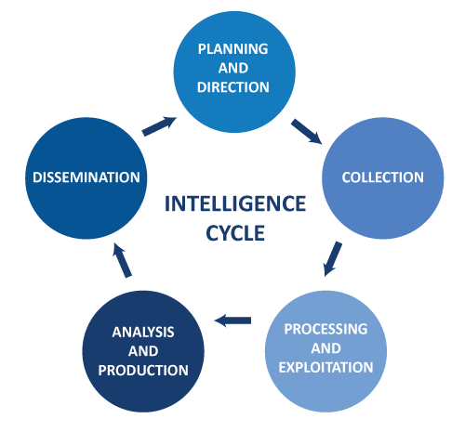
Decide what information is needed
Set objectives and priorities
Identify key questions to be answered
Feedback is received
New requirements arise
The cycle starts again
Gather raw data from relevant sources
Data may be structured or unstructured
Deliver the final intelligence to decision-makers
Present in reports, dashboards, or documents
Analyze processed information
Interpret patterns and insights
Produce conclusions or recommendations
Organize, clean, and prepare data
Remove irrelevant or duplicate information
Convert data into usable form

Slide 4
What is Artificial Intelligence?
  Artificial Intelligence (AI) is a branch of computer science that aims to create machines or programs that can perform tasks which normally require human intelligence.
  “AI is the science and engineering of making intelligent machines.”
  AI focuses on thinking, learning, reasoning, and acting intelligently.
  AI is the study of how to make computers do things, which at the moment people can do better.
  A branch of computer science that is concerned with the automation of intelligent behavior of human beings.
  A branch of computer science that is concerned with the development of a thinking machine. (Teach the machines how to think and they can think).
  A field of study in computer science that chases the goal of making a computer reason in a manner similar to humans.
  It involves the design and study of computer programs that behave intelligently.

Slide 5
What is Artificial Intelligence?
  AI is the study of ideas that enable computers to be intelligent.
  AI is the part of computer science concerned with design of computer systems that exhibit(Show outwardly) human intelligence.
  AI is the science of making machines do things that would require intelligence if done by people.
  It is the collection of problems and methodologies studied by AI researchers.

Slide 6
What is Artificial Intelligence?
AI is the part of computer science concerned with designing intelligent computer systems, that is, computer systems that exhibit the characteristics we associate with intelligence in human behavior-understanding language, learning, reasoning and solving problems.
Artificial Intelligence is based on Sound theoretical & applied principals of computer science such as
    Data structures used for knowledge representation,
    Algorithms needed to apply that knowledge,
    Programming techniques used in their implementation.

Slide 7
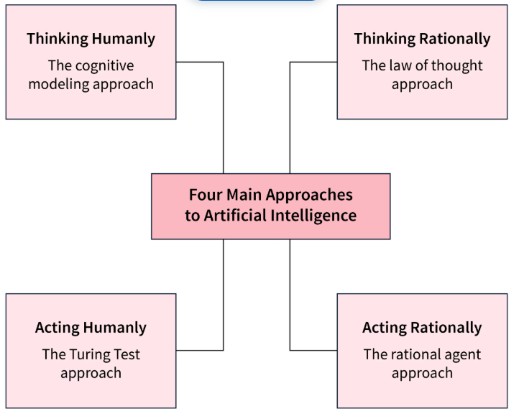
What is Artificial Intelligence?

Slide 8
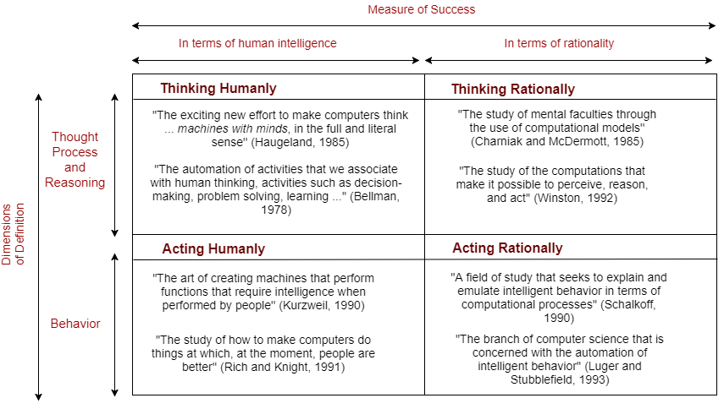
What is Artificial Intelligence?

Slide 9
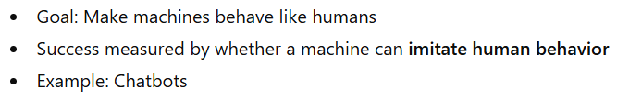
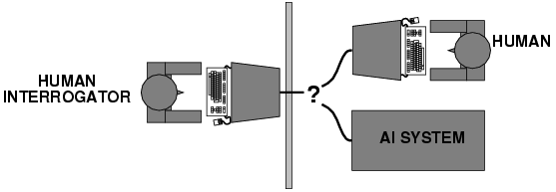
Acting humanly: Turing test
Turing (1950) "Computing machinery and intelligence":
"Can machines think?" → "Can machines behave intelligently?"
Operational test for intelligent behavior: the Imitation Game
Predicted that by 2000, a machine might have a 30% chance of fooling a lay person for 5 minutes
Anticipated all major arguments against AI in following 50 years
Suggested major components of AI: knowledge-based, automated reasoning, language understanding, learning

Slide 10
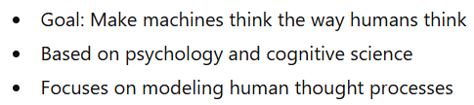
Thinking humanly: cognitive modeling
1960s "cognitive revolution": information-processing psychology
Requires scientific theories of internal activities of the brain
How to validate? Requires
  1) Predicting and testing behavior of human subjects (top-down) or
  2) Direct identification from neurological data (bottom-up)
  Both approaches (roughly, Cognitive Science and Cognitive Neuroscience)
are now distinct from AI
Notes:
Cognitive (how human brain thinks in each situation)

Slide 11
Thinking rationally: "laws of thought"
Aristotle: what are correct arguments/thought processes?
Several Greek schools developed various forms of logic: notation and rules of derivation for thoughts; may or may not have proceeded to the idea of mechanization
Direct line through mathematics and philosophy to modern AI
Problems:
  Not all intelligent behavior is mediated by logical deliberation
  What is the purpose of thinking? What thoughts should I have?

Slide 12
Acting rationally: rational agent
Rational behavior: doing the right thing
The right thing: that which is expected to maximize goal achievement, given the available information
Doesn't necessarily involve thinking e.g., blinking reflex – but thinking should be in the service of rational action

Slide 13
Schools of Thought
1. Weak AI (Narrow AI)
Weak AI refers to AI systems that are designed and trained to perform a specific task or a limited set of tasks. These systems do not possess consciousness or true understanding.
Task-specific and goal-oriented
Cannot think beyond programmed scope
No self-awareness or emotions
Works under predefined rules or learned patterns

Slide 14
Schools of Thought
1. Weak AI (Narrow AI)
Examples
Voice assistants (Siri, Google Assistant)
Recommendation systems (Netflix, YouTube)
Face recognition systems
Spam email filters
Chatbots used in customer support
Real-Life Explanation
  A calculator can solve math problems perfectly, but it does not understand mathematics. it only follows programmed rules.

Slide 15
Schools of Thought
2. Strong AI (General AI)
Strong AI refers to a hypothetical AI system that can think, reason, learn, and understand like a human being. It would possess general intelligence and possibly consciousness.
Human-level reasoning and learning
Can transfer knowledge across domains
Self-aware and autonomous (theoretical)
Capable of understanding meaning, not just patterns
Examples
No true Strong AI exists today. Fictional examples: Human-like robots in movies

Slide 16
Agents in AI
An artificial intelligence (AI) agent is a software program that can interact with its environment, collect data and use that data to perform self-directed tasks that meet predetermined goals. Humans set goals, but an AI agent independently chooses the best actions it needs to perform to achieve those goals.
An agent in Artificial Intelligence is an entity that perceives its environment through sensors and acts upon that environment through actuators to achieve specific goals.
An AI agent senses → decides → acts.
For example, consider a customer support AI agent that wants to resolve customer queries. The agent will automatically ask the customer different questions, look up information in internal documents and respond with a solution. Based on the customer responses, it determines if it can resolve the query itself or pass it on to a human.
Notes:
Percept (current, history)

Slide 17
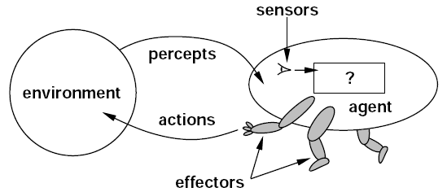
An environment provides information to the agent in the form of percepts.
The agent receives these percepts through its sensors.
Inside the agent, the percepts are processed to decide the best action.
The chosen action is sent to the effectors (actuators).
Effectors perform the action on the environment.
The environment changes, generating new percepts, and the cycle continues.
This shows how an AI agent continuously senses, decides, and acts.
Environment → Sensors → Agent → Actuators → Environment
Sensors: Collect information (camera, microphone, keyboard input)
Actuators: Perform actions (motor, screen display, speaker)
Notes:
Percept (current, history)

Slide 18
Agents in AI
Agent Function
An agent function maps percepts to actions.
f:Percepts→Actions
Takes current percept (or percept history)
Decides the best action

Slide 19
Agents in AI
Key Features of AI Agents
Autonomous: Act without constant human input and decide next steps from past data like a bookstore bot flags missing invoices.
Goal‑driven: Optimize for defined objectives like a logistics AI balancing speed, cost and fuel use.
Perceptive: Gather info from sensors, inputs or APIs like a cybersecurity agent tracking new threats.
Adaptable: Adjust strategies when situations change.
Collaborative: Work with humans or other agents toward shared goals like healthcare agents coordinating with patients and doctor.

Slide 20
Agents in AI
Example of an Agent
Human:
  Sensors: Eyes, ears
  Actuators: Hands, legs
Robot:
  Sensors: Camera, distance sensors
  Actuators: Wheels, arms
Software Agent:
  Sensors: User input, data streams
  Actuators: Display output, file updates

Slide 21
Agents in AI
AI Agent Classification
An agent is a system designed to perceive its environment, make decisions and take actions to achieve specific goals. Agents operate autonomously, without direct human control and can be classified based on their behavior, environment and number of interacting agents.
Reactive Agents: Respond to immediate environmental stimuli without foresight or planning.
Proactive Agents: Anticipate future states and plan actions to achieve long-term goals.
Single-Agent Systems: One agent solves a problem independently.
Multi-Agent Systems: Multiple agents interact, coordinate or compete to achieve goals; may be homogeneous (similar roles) or heterogeneous (diverse roles).
Rational Agents: Choose actions to maximize expected outcomes using both current and historical information.

Slide 22
Environment in AI
In AI, the environment is everything outside the agent that the agent interacts with.
The environment is the surroundings or situation where an agent operates.
It is the world in which the agent:
  Perceives through sensors
  Acts through actuators
  Tries to achieve its goals

Slide 23
Environment in AI
1. Self-Driving Car
  Agent: Autonomous car system
  Environment: Roads, traffic lights, pedestrians, weather
2. Chess Program
  Agent: Chess AI
  Environment: Chessboard and opponent
3. Robot Vacuum Cleaner
  Agent: Vacuum robot
  Environment: Room layout, furniture, dust

Slide 24
Types of environments
Fully Observable vs Partially Observable
When an agent sensor is capable to sense or access the complete state of an agent at each point in time, it is said to be a fully observable environment else it is partially observable.
Maintaining a fully observable environment is easy as there is no need to keep track of the history of the surrounding.
An environment is called unobservable when the agent has no sensors in all environments.
Fully Observable: Agent can see complete environment
(Chess game)
Partially Observable: Agent cannot see everything
(Driving in fog)

Slide 25
Types of environments
2. Deterministic vs Stochastic
When a uniqueness in the agent's current state completely determines the next state of the agent, the environment is said to be deterministic.
The stochastic environment is random in nature which is not unique and cannot be completely determined by the agent.
Deterministic: Next state fully determined by current state
(Chess)
Stochastic: Outcome involves uncertainty
(Weather system)

Slide 26
Types of environments
3. Episodic vs Sequential
In an Episodic task environment, each of the agent's actions is divided into atomic incidents or episodes. There is no dependency between current and previous incidents. In each incident, an agent receives input from the environment and then performs the corresponding action.
In a Sequential environment, the previous decisions can affect all future decisions. The next action of the agent depends on what action he has taken previously and what action he is supposed to take in the future.
Episodic: Each action independent
(Image classification)
Sequential: Current action affects future states
(Driving)

Slide 27
Types of environments
4. Static vs Dynamic
An environment that keeps constantly changing itself when the agent is up with some action is said to be dynamic.
A roller coaster ride is dynamic as it is set in motion and the environment keeps changing every instant.
An idle environment with no change in its state is called a static environment.
An empty house is static as there's no change in the surroundings when an agent enters.
Static: Environment does not change while agent thinks (Crossword puzzle)
Dynamic: Environment changes over time (Traffic system)

Slide 28
Types of environments
5. Discrete vs Continuous
If an environment consists of a finite number of actions that can be deliberated in the environment to obtain the output, it is said to be a discrete environment.
The game of chess is discrete as it has only a finite number of moves. The number of moves might vary with every game, but still, it's finite.
The environment in which the actions are performed cannot be numbered i.e. is not discrete, is said to be continuous.
Self-driving cars are an example of continuous environments as their actions are driving, parking, etc. which cannot be numbered.
Discrete: Finite states and actions(Chess)
Continuous: Infinite states(Robot movement in real world)

Slide 29
Types of environments
6. Competitive vs Collaborative
An agent is said to be in a competitive environment when it competes against another agent to optimize the output.
The game of chess is competitive as the agents compete with each other to win the game which is the output.
An agent is said to be in a collaborative environment when multiple agents cooperate to produce the desired output.
When multiple self-driving cars are found on the roads, they cooperate with each other to avoid collisions and reach their destination which is the output desired.

Slide 30
Types of environments
7. Single-agent vs Multi-agent
An environment consisting of only one agent is said to be a single-agent environment.
A person left alone in a maze is an example of the single-agent system.
An environment involving more than one agent is a multi-agent environment.
The game of football is multi-agent as it involves 11 players in each team.

Slide 31
PEAS Description of an Agent
In Artificial Intelligence (AI), various types of agents operate to achieve specific goals. The PEAS system is a critical framework used to categorize these agents based on their performance, environment, actuators, and sensors.
Understanding the PEAS system is essential for grasping how different AI agents function effectively in diverse environments. Among these agents, Rational Agents are considered the most efficient, consistently choosing the optimal path for maximum efficiency.
Performance Measure: The criteria that define the success of the agent's actions.
Environment: The surroundings or the context in which the agent operates.
Actuators: The mechanisms through which the agent interacts with the environment.
Sensors: The tools the agent uses to perceive its environment.

Slide 32
Types of Agents in AI
1. Simple Reflex Agents
Simple Reflex Agents act based solely on current perceptions using condition-action rules. These agents respond directly to stimuli without considering past experiences or potential future states. They operate on basic "if-then" logic: if a specific condition is detected, execute a corresponding action.
Key Features:
No memory of past states
No model of how the world works
Purely reactive behavior
Function best in fully observable environments
For Example, Traffic light control systems that change signals based on fixed timing.

Slide 33
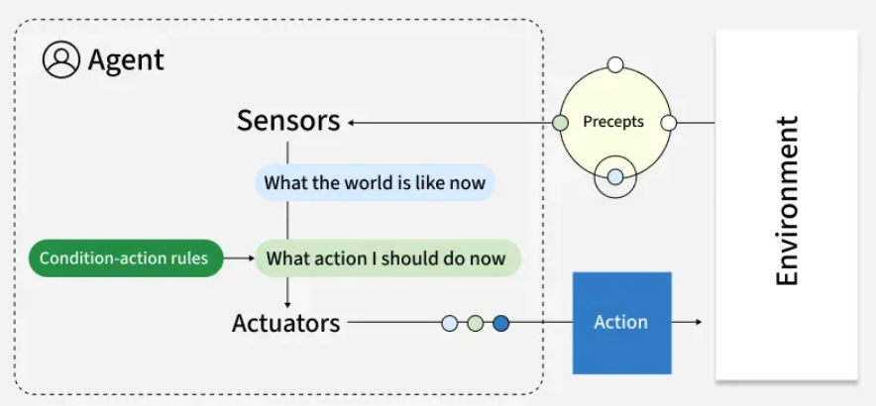

Slide 34
Types of Agents in AI
2. Model-based reflex Agents
Model-based reflex Agents maintain an internal representation of the world, allowing them to track aspects of the environment they cannot directly observe. This internal model helps them make more informed decisions by considering how the world evolves and how their actions affect it.
Key Features:
Track the world's state over time
Infer unobserved aspects of current states
Function effectively in partially observable environments
Still primarily reactive, but with contextual awareness
For example, Robot vacuum cleaners that map rooms and tracks cleaned areas.

Slide 35
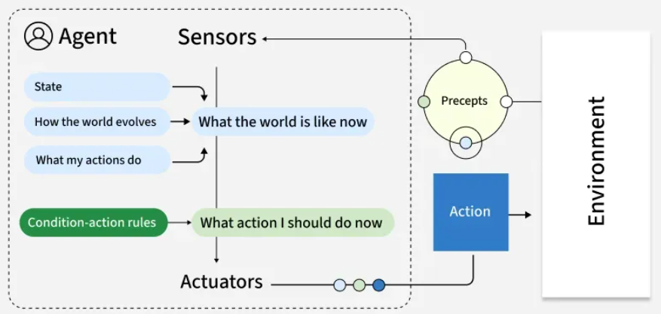
Types of Agents in AI
2. Model-based reflex Agents

Slide 36
Types of Agents in AI
3. Goal-Based Agents
Goal-based agents plan their actions with a specific objective in mind. Unlike reflex agents that respond to immediate stimuli, goal-based agents evaluate how different action sequences might lead toward their defined goal, selecting the path that appears most promising.
Key Features:
Employ search and planning mechanisms
Evaluate actions based on their contribution toward goal achievement
Consider future states and outcomes
May explore multiple possible routes to a goal
For example, Logistics routing agents that find optimal delivery routes based on factors like distance and time. They continually adjust to reach the most efficient route.

Slide 37
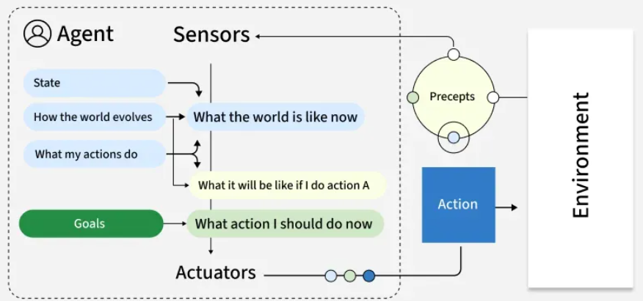
Types of Agents in AI
3. Goal-Based Agents

Slide 38
Types of Agents in AI
4. Utility-based agents
Utility-based agents extend goal-based thinking by evaluating actions based on how well they maximize a utility function, essentially a measure of "happiness" or "satisfaction." This approach allows them to make nuanced trade-offs between competing goals or uncertain outcomes.
Key Features:
Balance multiple, sometimes conflicting objectives
Handle probabilistic and uncertain environments
Evaluate actions based on expected utility
Make rational decisions under constraints
For example, Financial portfolio management agents that evaluate investments based on factors like risk, return and diversification operate by choosing options that provide the most value.

Slide 39
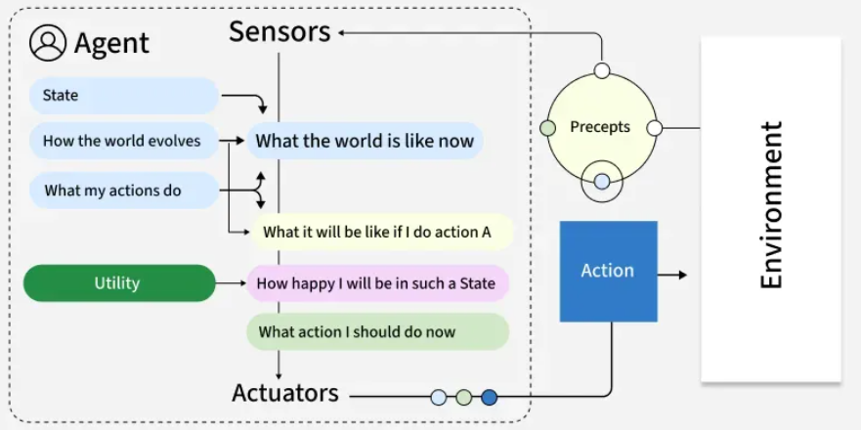
Types of Agents in AI
4. Utility-based agents

Slide 40
Types of Agents in AI
5. Learning Agents
Learning agents improve their performance over time based on experience. They modify their behavior by observing the consequences of their actions, adjusting their internal models and decision-making approaches to achieve better outcomes in future interactions.
Key Features:
Adapt to changing environments
Improve performance with experience
Contain both a performance element and a learning element
Generate new knowledge rather than simply applying existing rules
For example, Customer service chatbots can improve response accuracy over time by learning from previous interactions and adapting to user needs.

Slide 41
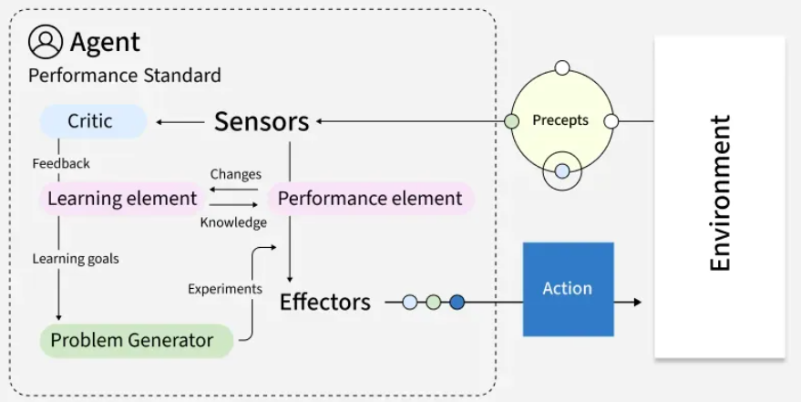
Types of Agents in AI
5. Learning Agents

Slide 42
Types of Agents in AI
6. Multi-agent systems
Multi-agent systems consist of multiple autonomous agents that interact with each other within an environment. These agents may cooperate toward common goals, compete for resources or exhibit a mix of cooperative and competitive behaviors. Types of multi-agent systems:
  Cooperative MAS: Agents work together toward shared objectives.
  Competitive MAS: Agents pursue individual goals that may conflict. Game
  Mixed MAS: Agents cooperate in some scenarios and compete in others.
Key Features:
Agents act independently and control their own state.
Agents align, collaborate or compete to reach goals.
The system remains resilient if individual agents fail.
Decisions are distributed; there’s no single controller.
For example, a warehouse robot might use:
Model-based reflexes for navigation. Goal-based planning for task sequencing. Utility-based decision-making for prioritizing tasks. Learning capabilities for route optimization

Slide 43
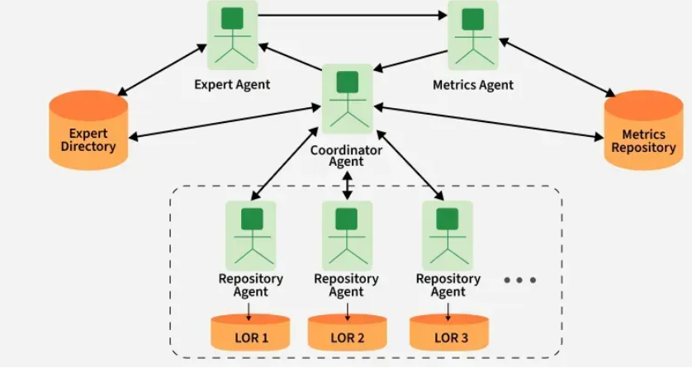
Types of Agents in AI
6. Multi-agent systems

Slide 44
Types of Agents in AI
7. Hierarchical agents
Hierarchical agents organize decision-making across multiple levels, with high-level agents making strategic decisions and delegating specific tasks to lower-level agents. This structure mirrors many human organizations and allows for managing problems at appropriate levels of abstraction.
Key Features:
Division of responsibilities across multiple levels
Abstract decision-making at higher levels
Detailed execution at lower levels
Simplified information flow (higher levels receive summarized data)
For example, Drone delivery systems in which fleet management is done at top level and individual navigation at lower level.

Slide 45
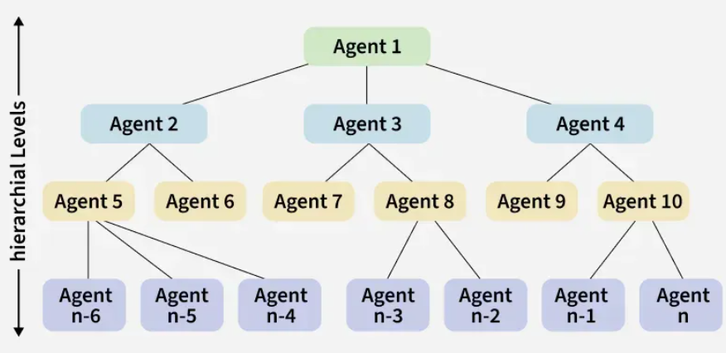
Types of Agents in AI
7. Hierarchical agents

Slide 46
Agents in AI
Benefits of AI Agents
Fast and efficient operations.
Adapt and learn from experience.
Scalable for large or complex problems.
Operate autonomously with minimal human input.
Consistent, reliable task performance.
Limitations:
Struggle with complex or unpredictable environments.
High computational needs for learning and planning.
Communication issues in multi-agent setups.
Risk of bias or unintended actions.
Challenges in designing clear goals and utility functions.

Slide 47
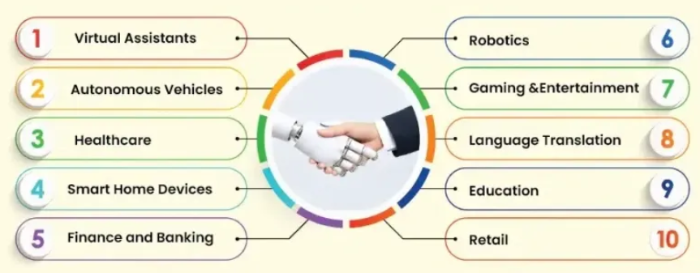
Using artificial intelligence in real life

Slide 48
History and evolution of AI
1950: Alan Turing proposed the concept of machine intelligence and the Turing Test. “can machine think like human” (Turing test)
1956: The term Artificial Intelligence was coined at the Dartmouth Conference (Dartmouth college). By john mcCarthy
1960s–1970s: Development of early AI programs such as ELIZA (chatbot) and General Problem Solver.
1980s: Rise of expert systems and knowledge-based systems.
1990s–2000s: Growth of machine learning and data-driven approaches.
Recent Years: Advances in deep learning (NN), natural language processing, and generative AI.
Notes:
1954 death. 1950 to 1956 (Classical/symbolic/problem solving AI era), expert systems(simple if-else), 2023 (chatgbt) 2018 (gbt, gbt2, gbt3)

Slide 49
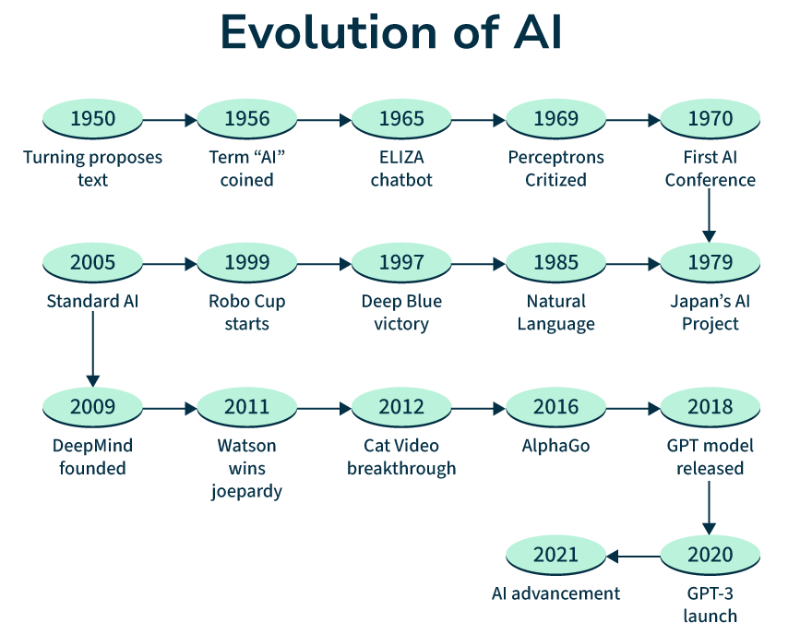

Slide 50
Assignment
Exploring Different Types of AI Agents with PEAS Examples
PEAS Table Challenge
Weak AI or Strong AI? Siri, Calculator, Chess AI, Self-driving car
P | E | A | S

Slide 51
Thank You ☺

